Slide 1
Bank Demo on CDP DataCenter
Sunita Sharma | Senior Solution Architect
Between January and September 2019 there were over 7.9 billion data records exposed — a 33% increase from the same time in 2018! : by 2020-data-breaches
Let’s build secured data pipeline together

Slide 2
Agenda
CDP (Cloudera Data Platform) Overview
CDP Data Center with Best of Security And Governance
CDP Data Center Shared Data Xperience
Bank Demo with Ranger
Setting up EMR with Ranger
Key Takeaways

Slide 3
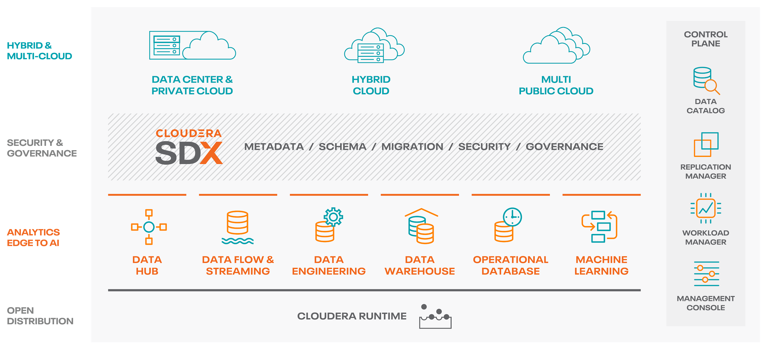
CLOUDERA DATA PLATFORM Overview
Notes:
CDP is the home for heterogeneous data processing and storage.It is well architected for end to end data pipeline where data can be ingested from various source, processed and ready to be served to Advance analytics and ML focused projects.
It is well secured with SDX , gives end user single place managing metadata/schema/security and governance.
We will talk in detail about in sections below. With post merger last year, we picked the best of both the world technology and prepare the CDP data platform . let’s look into next slide as what is new.

Slide 4
A NEW OPEN SOURCE DISTRIBUTION FOR BETTER CAPABILITY
Cloudera Runtime 7.0 – created from the best of CDH and HDP
Adopt superior technologies
Merge overlapping technologies
Keep complementary technologies
Upgrade shared technologies
Ambari | Cloudera Manager
Sentry | Ranger
Cloudera Director | Cloudbreak
Hive on Spark | Hive on Tez
Navigator + Atlas + DSS
WXM + DAS
BDR + DLM
Hue + DAS Lite
Impala | Hive LLAP w/HWC
Parquet | ORC
Kudu | Hive ACID + Druid
CDSW | Zeppelin
NiFi | Phoenix
Knox | Livy
Hadoop 3.1 | Spark 2.4
Hive 3.1 | Oozie 5.1
HBase 2.2 | Accumulo 1.9
Kafka 2.1 | Sqoop 1.4
Solr 7.4 | Zookeeper 3.4
Notes:
Users coming for HWX , will see new adoption with CM,
While User coming from CDH , will see new adoption in security model , replacing sentry with Ranger.
Currently there is no direct path to upgrade, but going into future , we will have path as slide below

Slide 5
Upgrade Path
CDP Private Cloud
CDP Data Center provides the stateful elements for new wave of containerized compute applications
Storage
Table Schema
Authentication & Authorization
Governance
Plan your path to CDP-DC now, expand to new experiences later
Management Console
Data Hub
CDW
CML
CDP Data Center
(SDX environment)
CDH 5 / HDP 2
CDH 6 / HDP 3
Existing Apps
Upgrade
Existing Apps
Upgrade
Existing Apps
Existing Data
Existing Data
Existing Data
Upgrade
Existing Hardware
Existing Hardware
Existing Hardware
Notes:
This is also foundation for Private cloud

Slide 6
Existing CHALLENGES With Current Model w/o SDX
Security & Governance
Sharing data across workloads
Requires multiple copies of data need to be created
Each with its own set of data context
Burdensome admin effort
Multiple clusters = multiple places to administer
One missing permission in one copy of the data can lead to significant financial and reputation risk
Difficult to share data safely for new analyses
Heavy new regulation such as GDPR makes the challenges even greater

Slide 7

CDP Security Landscape
Watch Towers
Inner Walls
Kerberos
Apache Ranger
High Walls
CDP
User Identity Verification
HDFS Encryption
Apache Ranger KMS
LDAP/AD
Moat
Limited Entry Points
Firewall
Apache Knox
Notes:
The Apache Knox™ Gateway is an Application Gateway for interacting with the REST APIs and UIs of Apache Hadoop deployments.
The Knox Gateway provides a single access point for all REST and HTTP interactions with Apache Hadoop clusters.
Knox delivers three groups of user facing services:

Slide 8
COMPREHENSIVE APPROACH TO SECURITY
Identity & Perimeter
Validate users in enterprise directory
Technical Concepts:
Authentication
User/group mapping
Access
Defining what users and applications can do with data
Technical Concepts:
Permissions
Authorization
Visibility
Reporting on where data came from and how it’s being used
Technical Concepts:
Auditing
Lineage
Data Protection
Shielding data in the cluster from unauthorized visibility
Technical Concepts:
Encryption, Key Management
Kerberos,
Apache Knox
Apache Ranger
Apache Atlas
SSL/TLS, HDFS TDE, Ranger
(KMS, Masking, Filtering)
80% of large customers leverage our capabilities across all 4 pillars,
to address use cases that include sensitive and regulated data.

Slide 9
Ranger Architecture
RANGER ARCHITECTURE
Ranger Administration Portal
Legacy Tools and Data Governance
Enterprise Users
Ranger User/Group Sync
Ranger Policy Server
Integration API
HDFS
Ranger Plugin
Ranger Plugin
Knox
HiveServer2 / Impala*
Ranger Plugin
Ranger Plugin
Solr
Hadoop Components
HBase
Ranger Plugin
Ranger Plugin
Kafka
NiFi
Ranger Plugin
Ranger Plugin
YARN
Storm
Ranger Plugin
Ranger Plugin
Atlas
Notes:
The Ranger Admin portal is the central interface for security administration. Users can create and update policies, which are then stored in a policy database. Plugins within each component poll these policies at regular intervals. The portal also consists of an audit server that sends audit data collected from the plugins for storage in HDFS or in a relational database.
Ranger plugins: Plugins are lightweight Java programs which embed within processes of each cluster component. For example, the Apache Ranger plugin for Apache Hive is embedded within Hiveserver2.These plugins pull in policies from a central server and store them locally in a file. When a user request comes through the component, these plugins intercept the request and evaluate it against the security policy. Plugins also collect data from the user request and follow a separate thread to send this data back to the audit server.
User group sync: Apache Ranger provides a user synchronization utility to pull users and groups from Unix or from LDAP or Active Directory. The user or group information is stored within Ranger portal and used for policy definition

Slide 10
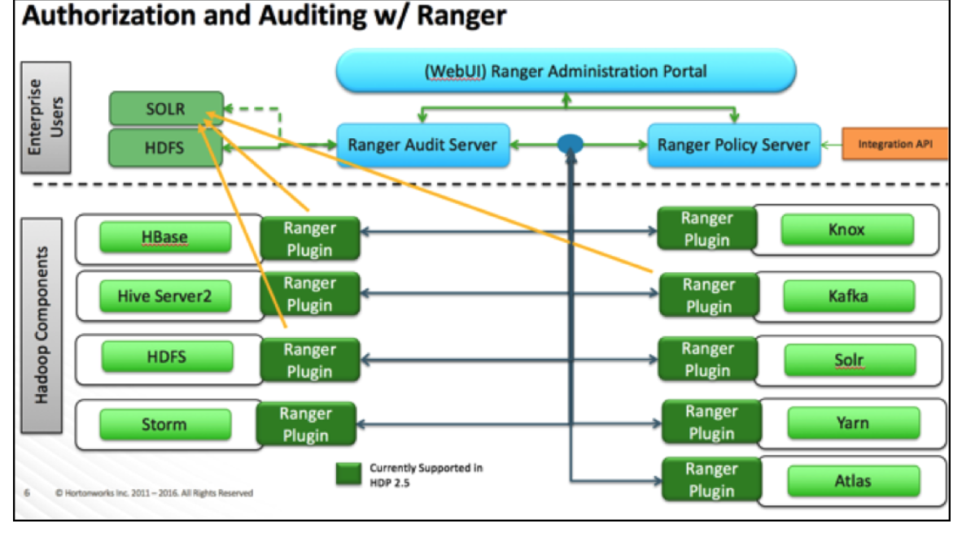

Slide 11
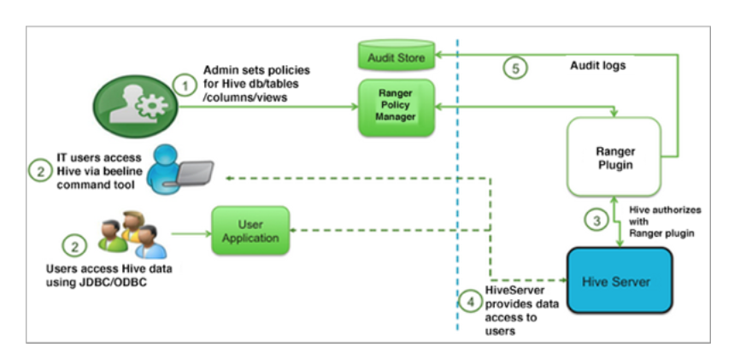
Ranger Authorization for Hive
1 Column level masking
2 Row level filtering
3 Policy Audits
Notes:
https://docs.cloudera.com/HDPDocuments/HDP3/HDP-3.1.5/securing-hive/content/hive_hive_authorization_models.html
https://docs.cloudera.com/HDPDocuments/HDP3/HDP-3.1.5/configuring-ranger-authe-with-unix-ldap-ad/content/ad_authentication_settings.html

Slide 12


Bank Demo Scenario
HR / Admin
EU Employee
US Employee
EU Finance Data
US Finance Data
Notes:
Only US employees can see data in us_customers table and only from locations within the US (access_us_customers)
US employees can see only data rows of US persons in ww_customers table (“filter_ww_customers for consent” + access_ww_customers)
EU employees can see only data rows of EU persons who have given consent in ww_customers table (“filter_ww_customers for consent” + access_ww_customers)
HR team members can see all original unmasked data (PCI, PII,….)
Super users belonging to etl/DPO groups can see data for all EU customers
Masking: Analysts can view only masked versions of sensitive data from ww_customers table but are prohibited from viewing PII data in the us_customers table(s) (All masking policies under Masking Tab of Resource based policies)
Prohibition: No combination of zip code, insurance, and bloodgroup data are permitted to be joined in any query (prohibition policy)
Hyper Bank – mid-size financial services company (Hyper Bank merged with WWAssurance health insurance services) expanding from US to international markets
Employees in EU and US
Multiple business units need access to customer data: Analysts, Compliance Admins, HR
Customer data is co-mingled as well as isolated
Leases data from external data brokers
Needs to have rational security policies to provide the right level of access control to customer data across geographies, business functions, and to comply with external regulations (GDPR, PII, HIPAA, EU Privacy etc.)

Slide 13
Ranger Set up
User Group |  | Access Privileges
joe_analyst | us_employee | US Data Only, non-sensitive data only, rest masked or forbidden depending on sensitivity
ivanna_eu_hr | eu_employee | EU Data Only (only customers who gave consent), All sensitive data
etl_user | eu_employee | EU Data (all customers), All sensitive data, Update consent/Delete
Data Column Masking Type |  | Sample Output
Password | Hash | 237672b21819462ff39fcea7d990c3e5
National ID | Last 4 Only | xx-xx-9324
Credit card | First 4 Only | 4532xxxxxxxxxxxx
Street Address | Static | nnn Xxxxxx Xxxxx
MRN** | NULL | null
Birthdate | Custom | Hide birthday by showing it as 01/01/yyyy
Age | Custom | (Add a random number below 20 to actual age)
Notes:
Hive = large joins,analytical style workloads, Impala = interactive BI style queries

Slide 14




DYNAMIC ROW FILTERING & COLUMN MASKING
User : Joe
Location : US
Group: Analyst
Users from US Analyst group see data for US persons with CC and National ID (SSN) as masked values and MRN is nullified
EU HR Policy Admins can see unmasked but are restricted by row filtering policies to see data for EU persons only
User 2: Ivanna
Location : EU
Group: HR
Country | National ID | CC No | MRN | Name
US | xxxxx3233 | 4539 xxxx xxxx xxxx | null | John Doe
US | xxxxx7465 | 5391 xxxx xxxx xxxx | null | Jane Doe
Country | National ID | Name | MRN
Germany | T22000129 | Ernie Schwarz | 876452830A
Analysts
HR
Marketing
Original Query:
SELECT country, nationalid, name, mrn FROM ww_customers
Ranger Policy Enforcement
Query Rewritten based on Dynamic Ranger Policies: Filter rows by region & apply relevant column masking
Original Query:
SELECT country, nationalid, ccnumber, mrn, name FROM ww_customers
Country | National ID | CC No | DOB | MRN | Name | Policy ID
US | 232323233 | 4539067047629850 | 9/12/1969 | 8233054331 | John Doe | nj23j424
US | 333287465 | 5391304868205600 | 8/13/1979 | 3736885376 | Jane Doe | cadsd984
Germany | T22000129 | 4532786256545550 | 3/5/1963 | 876452830A | Ernie Schwarz | KK-2345909
Notes:
Access : define users for each table ,DB u need to provide select,insert options
Row level filtering for each user , set up filter name eg Country =’US’ for US user
Column masking for hide column values or mask some char
Eg masking CC# with hash for user in US , for table and DB name
The community has been hard at work on integrating Apache Atlas as a metadata catalog and Apache Ranger as the centralized security system to address this need.
The result is tag-based authorization model driven by the metadata catalog (i.e. Atlas) with access and audit policies applied to those tags (via Ranger).
This enables a more flexible way to govern access to data and data sets than traditional role/group based access policies.
Ex. as data pipelines land data, they can tag that data as the data lands and the access policies setup for those tags immediately apply.
Moreover, Ranger has added the notions of time-based and location-based access policies, so users can do things like limit access to data that’s older than 90 days (for example) or limit access to data from certain geographies.
This provides important enterprise-focused capabilities that will help businesses deploy more modern data applications in a way where they have the confidence their data is secure and well-governed.
[NEXT]

Slide 15
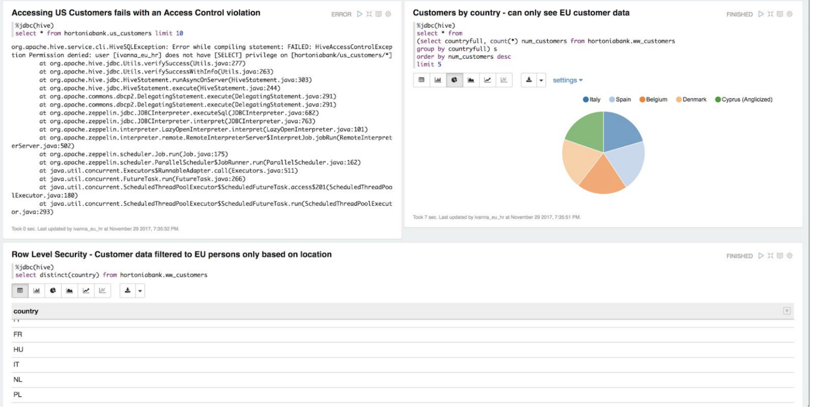
Access for US/EU customer in Notebook

Slide 16
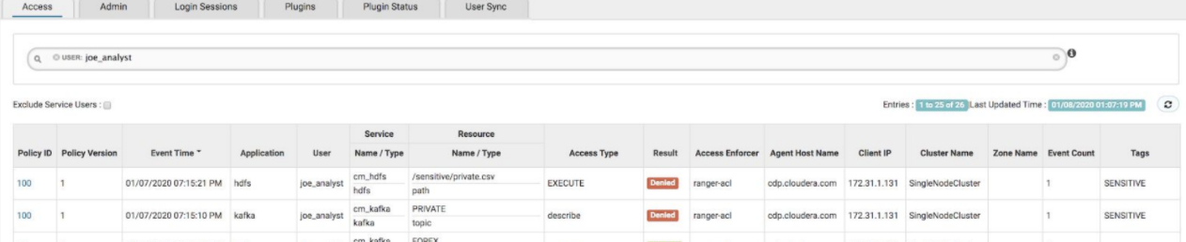
US employee Audit

Slide 17
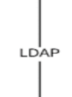
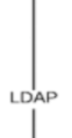
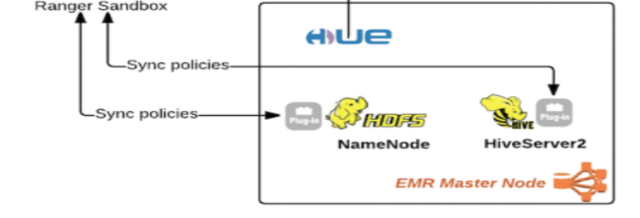
EMR with Ranger
Simple AD

Slide 18
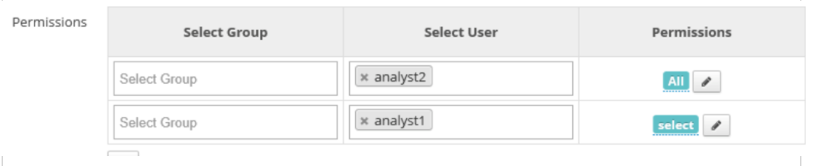
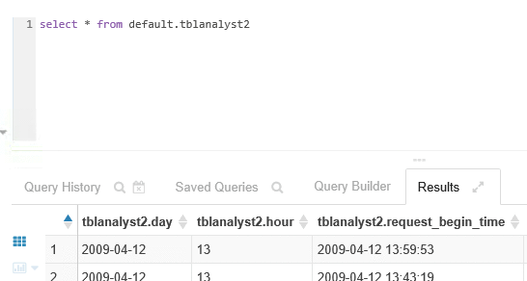
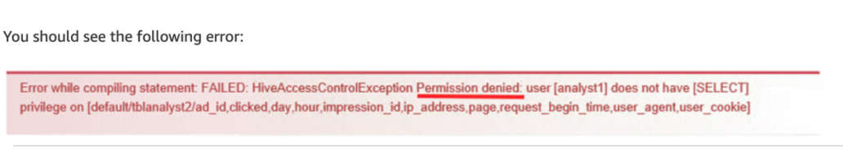
EMR Ranger Demo
User Group |  | Access Privileges
Analyst1 | analyst | Select Privilege on table tblanalyst1
Analyst2 | admin | Superuser ( ALL ) on table tblanalyst1 tblanalyst1
1
2
3
4
Notes:
Hive = large joins,analytical style workloads, Impala = interactive BI style queries

Slide 19
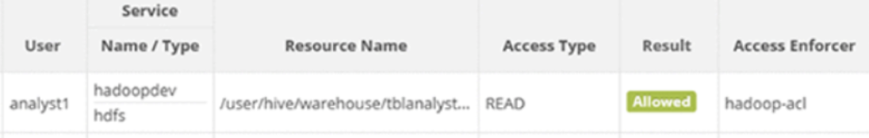
Ranger Audits

Slide 20
Key Takeaways
CDP brings best of both worlds ( HWX and CLDR combined)
Unified Security and Governance using SDX on CDP
Ease of Deployment
Ranger for Data Protection and Audits
Designed to be adopted on Public cloud or Private cloud with ease.
EMR can be set with Ranger Policies to obtain same security audits.
Notes:
Using LDAP via AWS Directory Service to Access and Administer Your Hadoop Environment
https://aws.amazon.com/blogs/big-data/using-ldap-via-aws-directory-service-to-access-and-administer-your-hadoop-environment/

Slide 21
Backup slides

Slide 22
EMR Key Benefits
Cost Savings ( on demand set up)
AWS Integration ( S3,Cloudwatch VPC)
Deployment ( easy deployment)
Scalability and Flexibility ( scale up or down , flexible to use fs HDFS,S3, EMRFS)
Reliability ( auto terminate option)
Security ( IAM Security, VPC, NACL settings)
Monitoring ( Cloudwatch )
Management Interfaces
Notes:
EMR is part of AWS Cloud
It can be easily created
EMR can take advantage of storing data on S3 on AWS , While CDP DC requires one time replication of data on S3 or can be access directly from CDP DC
Add strong security using IAM.
Easy to scale out
Managed services

Slide 23
Setting up Ranger on EMR
1
2
3
Ranger
User sync
EMR : Core services
AD Server
Ranger
Admin portal
Ranger Plugins
Hiveserver2
Ranger Audit Logs
HDFS
Notes:
Role-based access control (RBAC) is an important security requirement for multi-tenant Hadoop clusters. Enforcing this across always-on and transient clusters can be hard to set up and maintain.
For the organization that has an RBAC matrix using Active Directory users and groups. They would like to manage it on a central security policy server and enforce it on all Hadoop clusters that are spun up on AWS. This policy server should also store access and audit information for compliance needs.
Ranger is not a default plug-in for EMR. Ranger can be plugged into existing EMR with following set up or simply use Cloudformation templates:
1 > Set up AD server
2> Set up Ranger Server ( Using AD users)
3> Set up EMR with Ranger Plugin

Slide 24
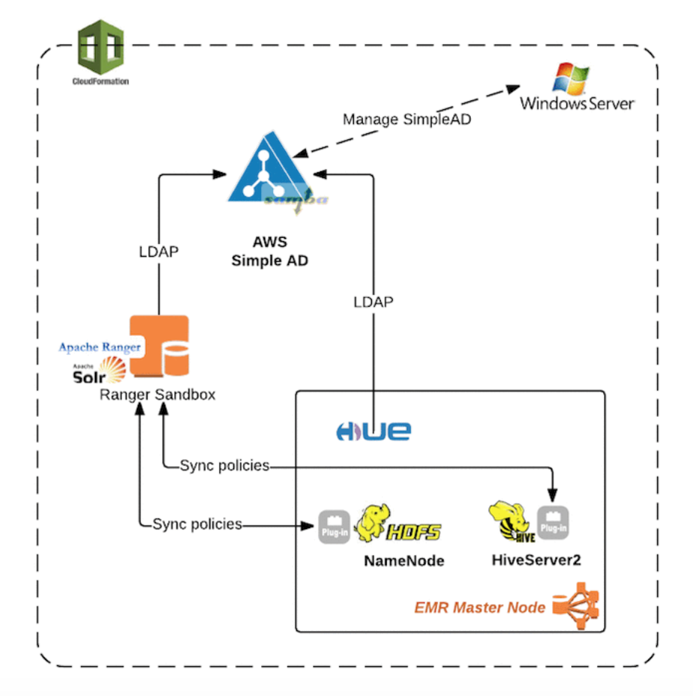
Setting up Ranger on EMR

Slide 25
Hive on Amazon EMR
Amazon EMR supports Hive Authorization for HDFS but not for EMRFS and Amazon S3.
ACID (Atomicity, Consistency, Isolation, Durability) transactions are not supported with Hive data stored in Amazon S3.
Queries that generate a large number of dynamic partitions may fail, and queries that select from tables with many partitions may take longer than expected to execute. For example, a select from 100,000 partitions may take 10 minutes or more.
Amazon EMR 6.0.0 supports the Live Long and Process (LLAP) functionality for Hive. LLAP uses persistent daemons with intelligent in-memory caching to improve query performance compared to the previous default Tez container execution mode.
If you need the metastore to persist, you must create an external metastore that exists outside the cluster. ( with RDS or AWS Glue Data Catalog)
Notes:
https://aws.amazon.com/blogs/big-data/implementing-authorization-and-auditing-using-apache-ranger-on-amazon-emr/

Slide 26
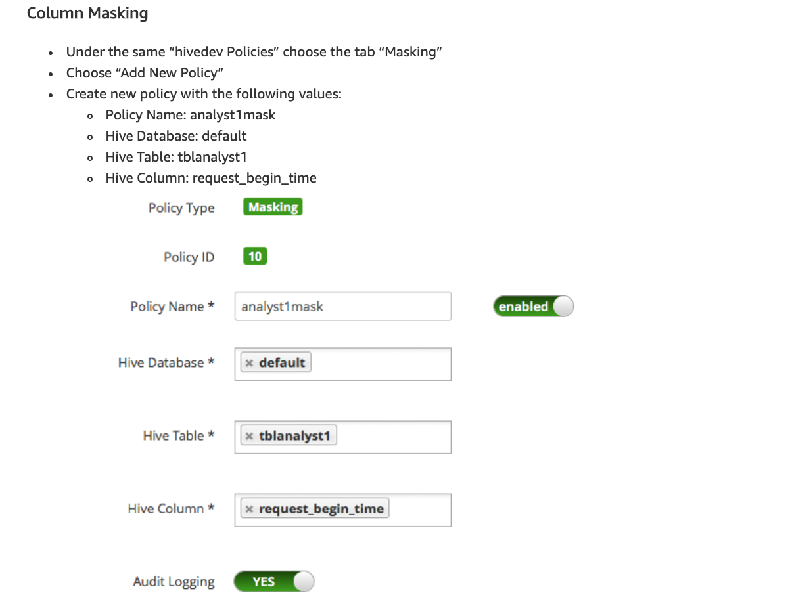

Slide 27
Resources
https://aws.amazon.com/blogs/big-data/using-ldap-via-aws-directory-service-to-access-and-administer-your-hadoop-environment/
https://aws.amazon.com/blogs/big-data/implementing-authorization-and-auditing-using-apache-ranger-on-amazon-emr/

Slide 28
Setting up a SimpleAD server
To Set up Ranger with EMR
You need
1 > Set up AD Directory ( Simple AD with 2 users :Admin and Analyst )
2 Set up Ranger Server ( Set up Masking Policy)
3> Set up EMR Cluster with Core services ( Test Hive with different users)
Notes:
https://aws.amazon.com/blogs/big-data/implementing-authorization-and-auditing-using-apache-ranger-on-amazon-emr/
SimpleADCF20

Slide 29
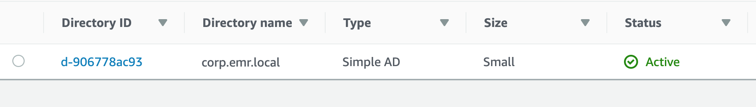
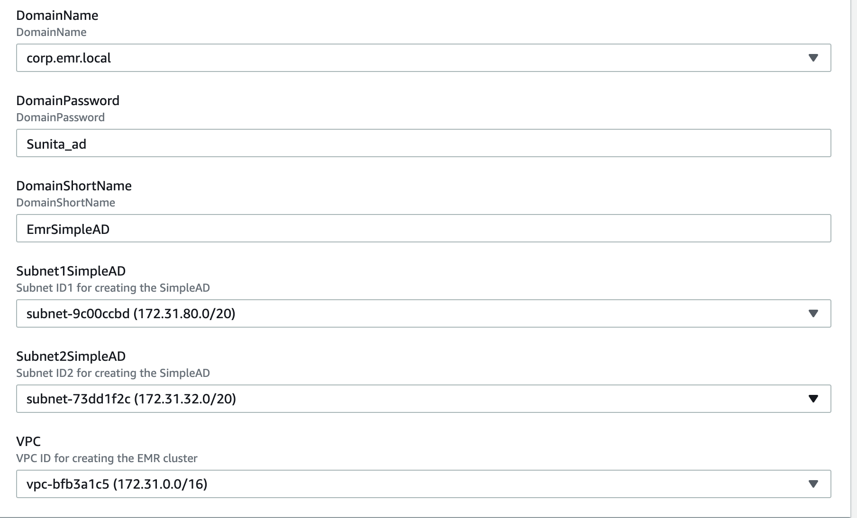
Step 1 : Set up Active Directory
Notes:
https://aws.amazon.com/blogs/big-data/implementing-authorization-and-auditing-using-apache-ranger-on-amazon-emr/
SimpleADCF20

Slide 30
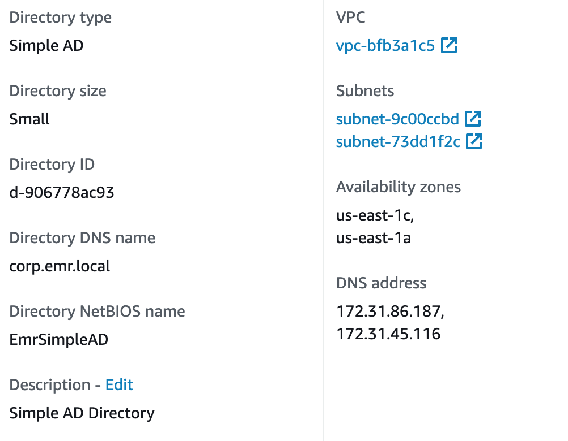
SimpleAD

Slide 31
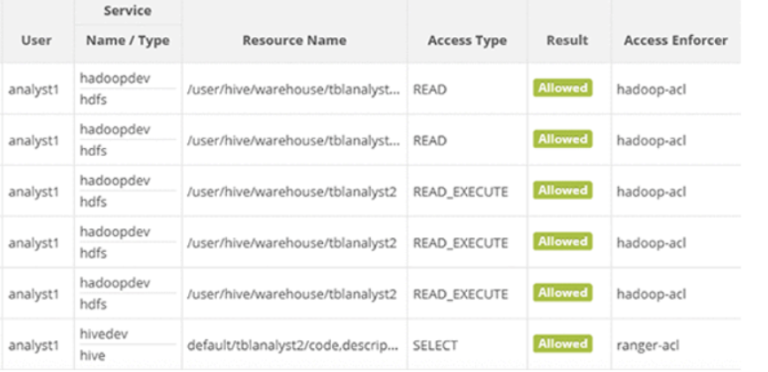
Ranger Audits in EMR

Slide 32
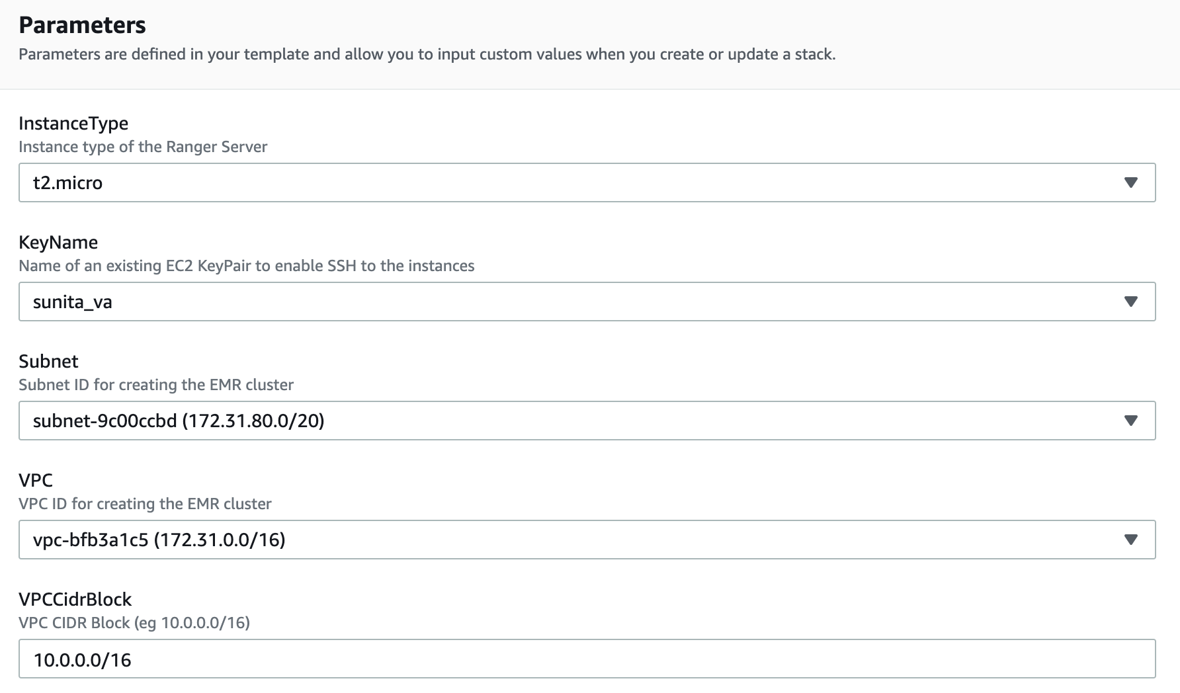

Slide 33
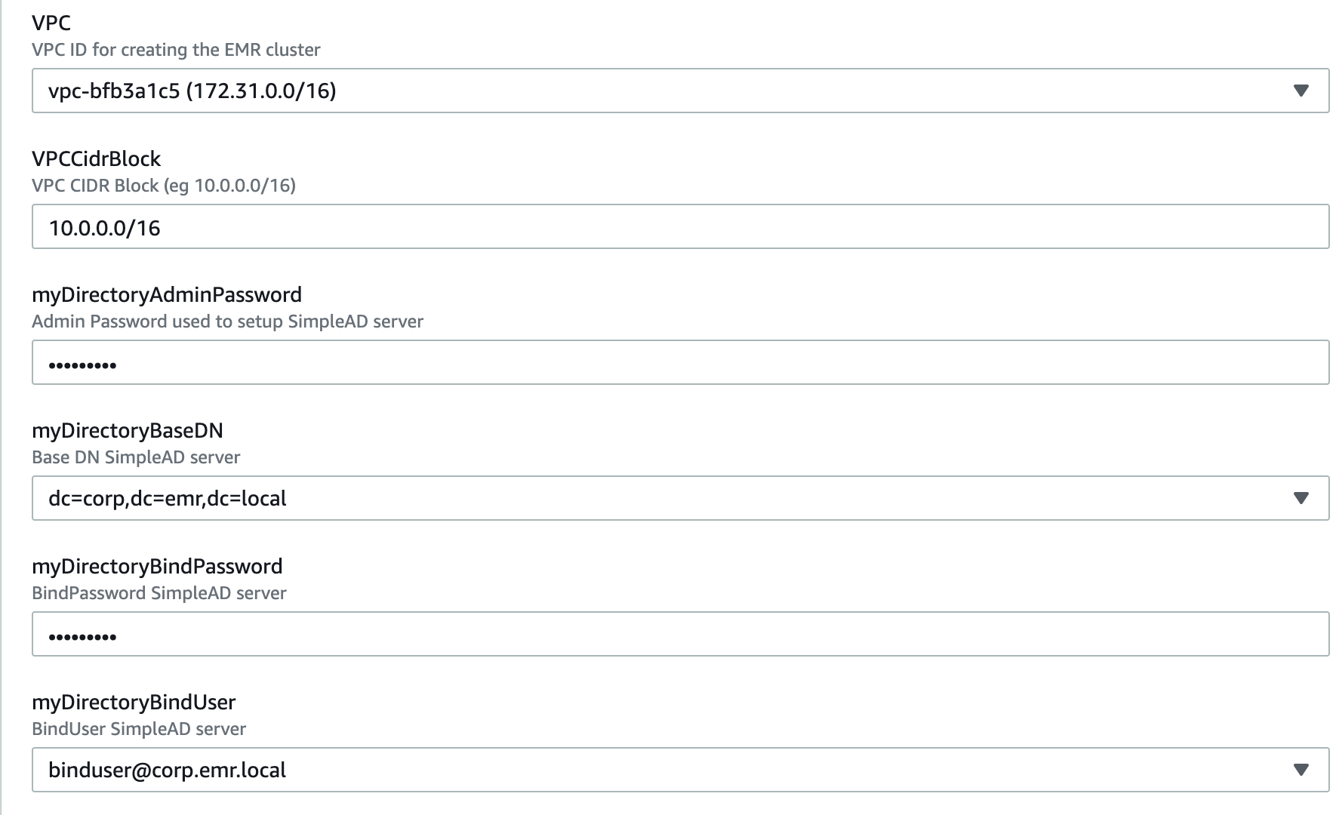
Notes:
Sunitaad

Slide 34
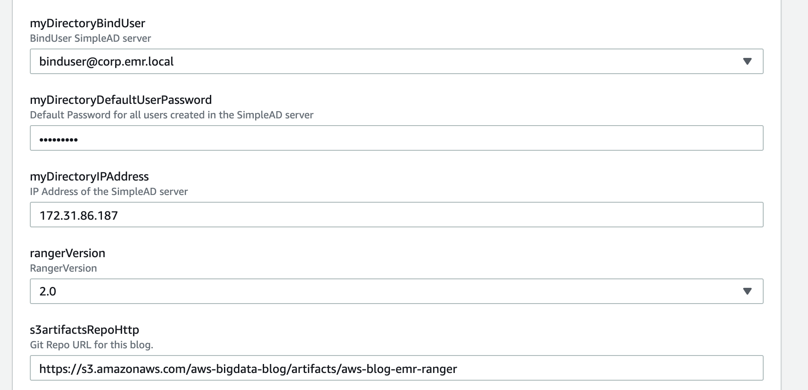
Notes:
Sunitaad

Slide 35
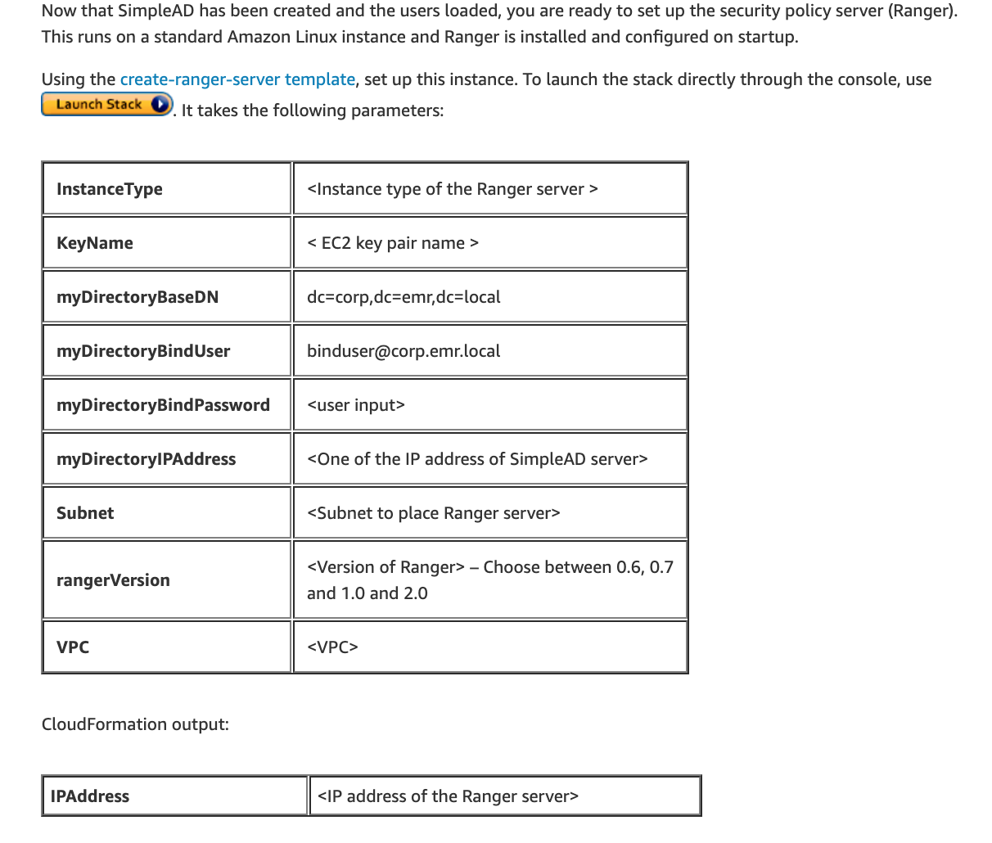
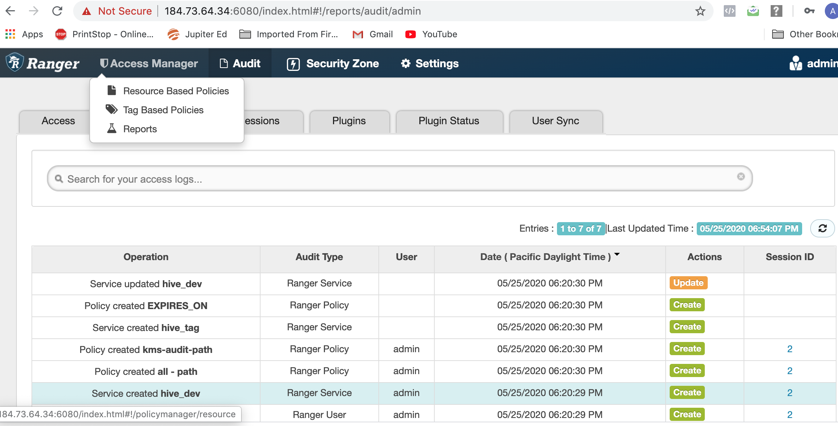
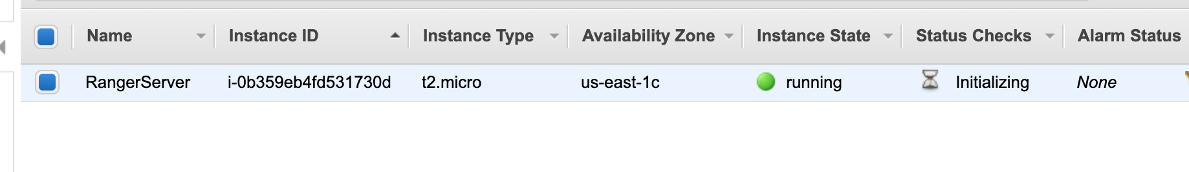
Setting up the Ranger server
Notes:
IP 54.146.220.44

Slide 36
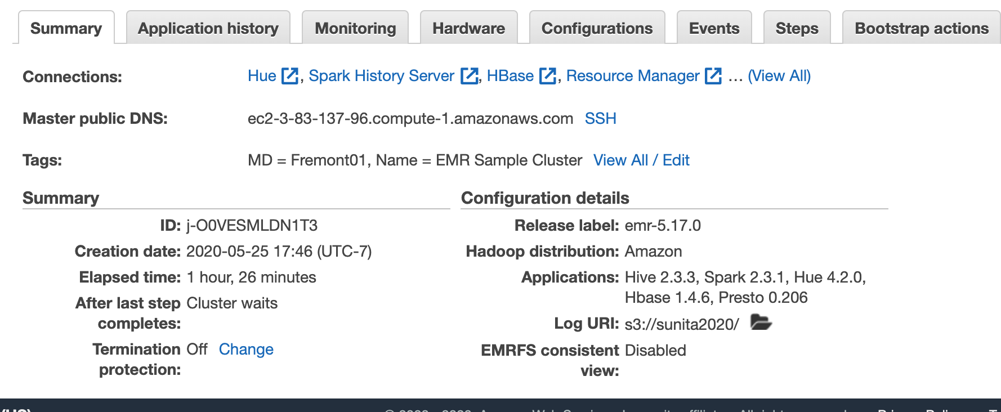
EMR Instance

Slide 37
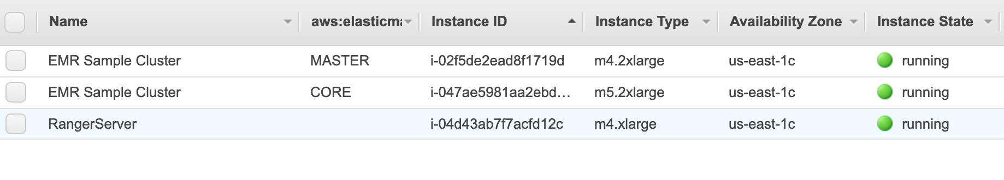
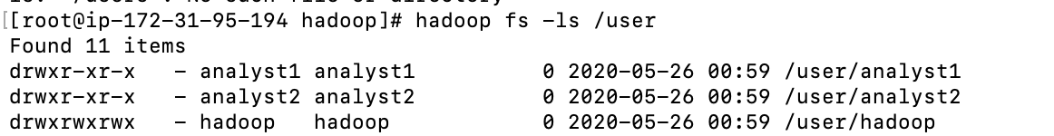
EMR set up

Slide 38
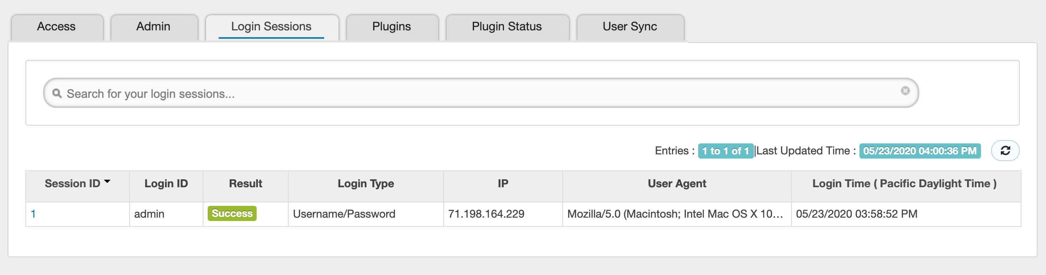
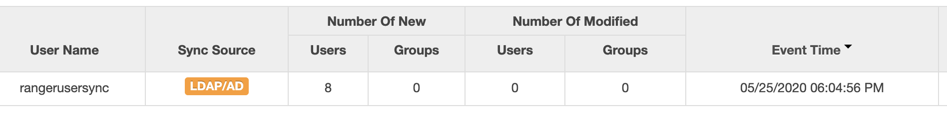
Login details Audit from Ranger

Slide 39
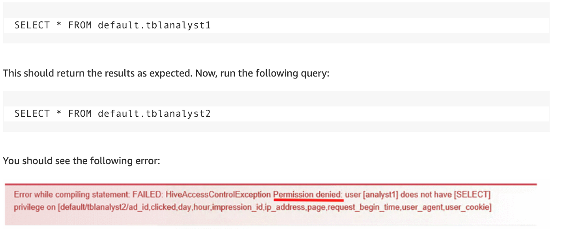
Execute query with Analyst 1

Slide 40
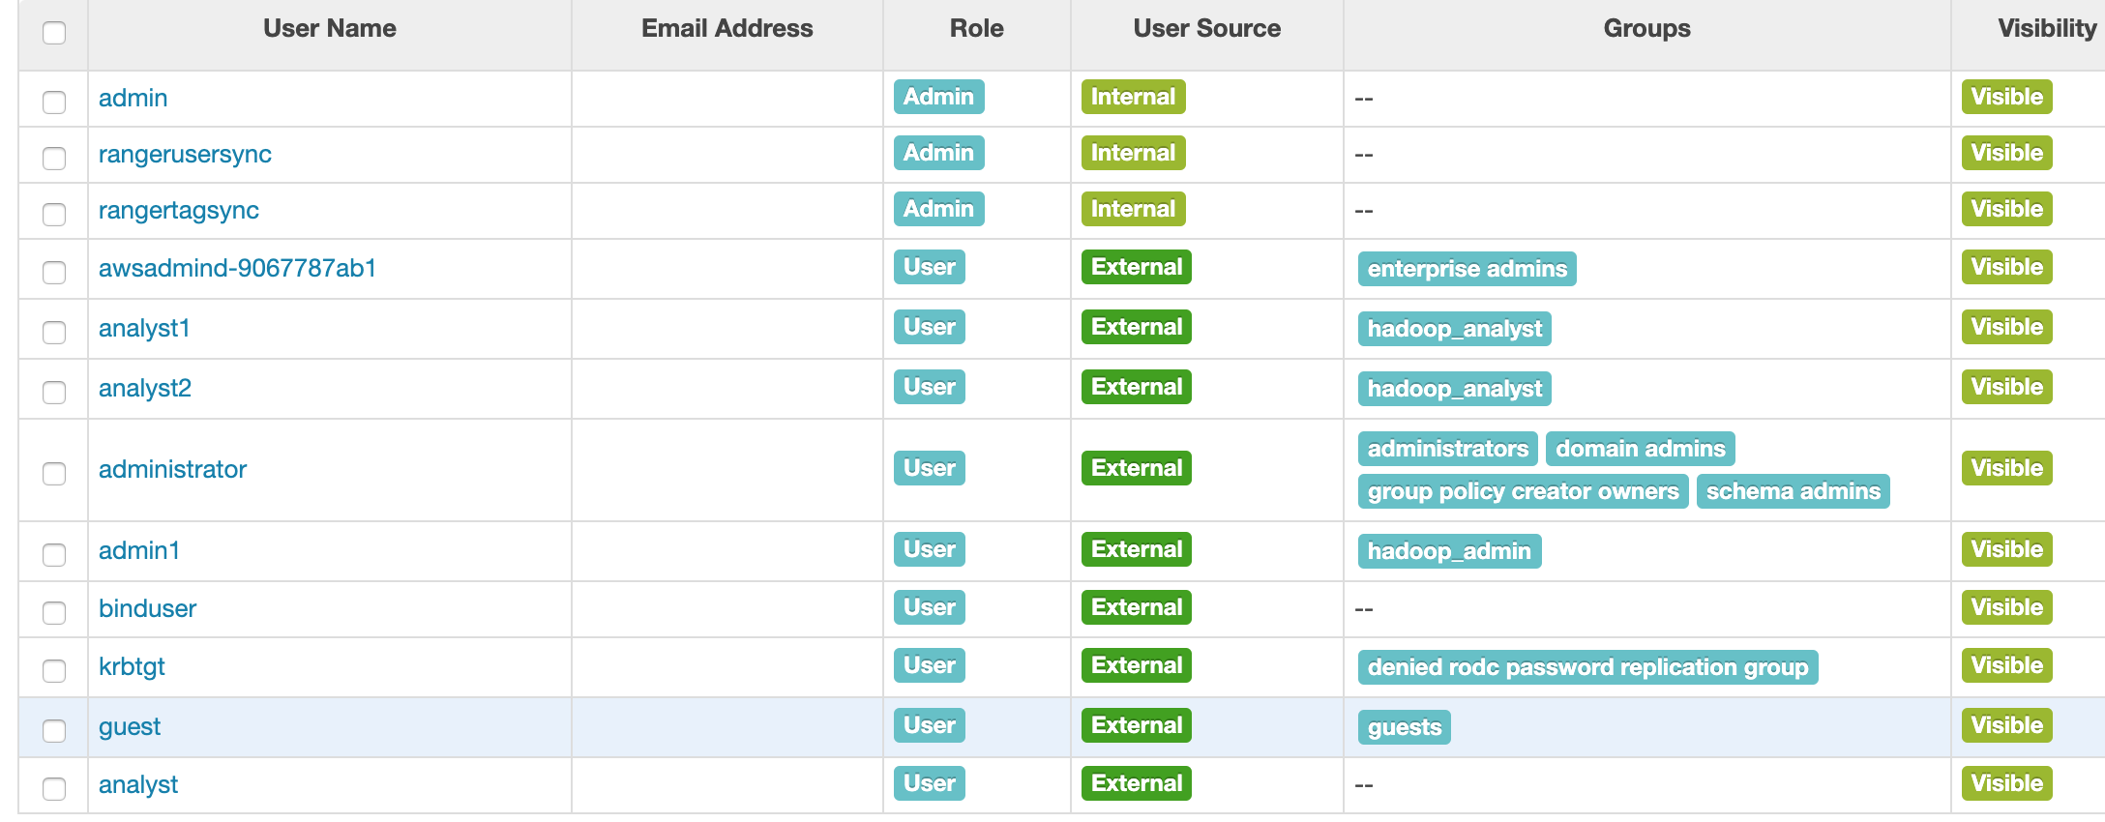
Users/ Group in Ranger

Slide 41
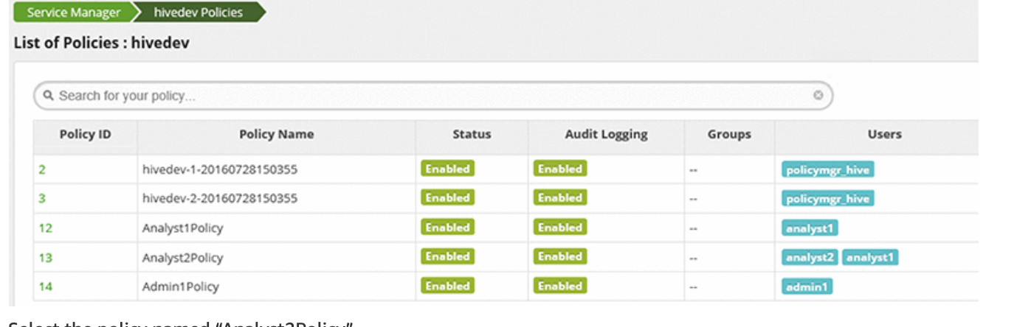
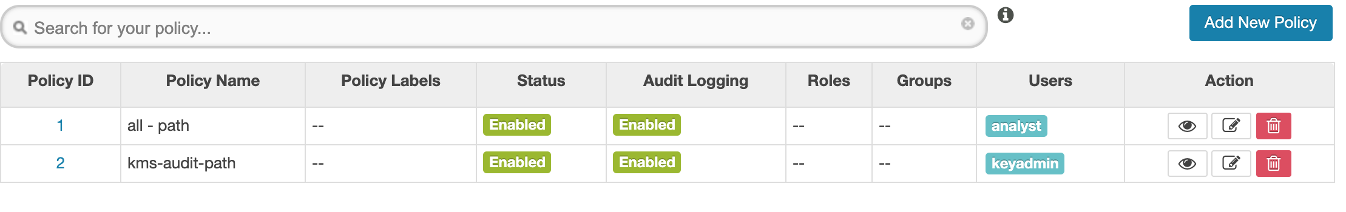
Policies for Analyst

Slide 42
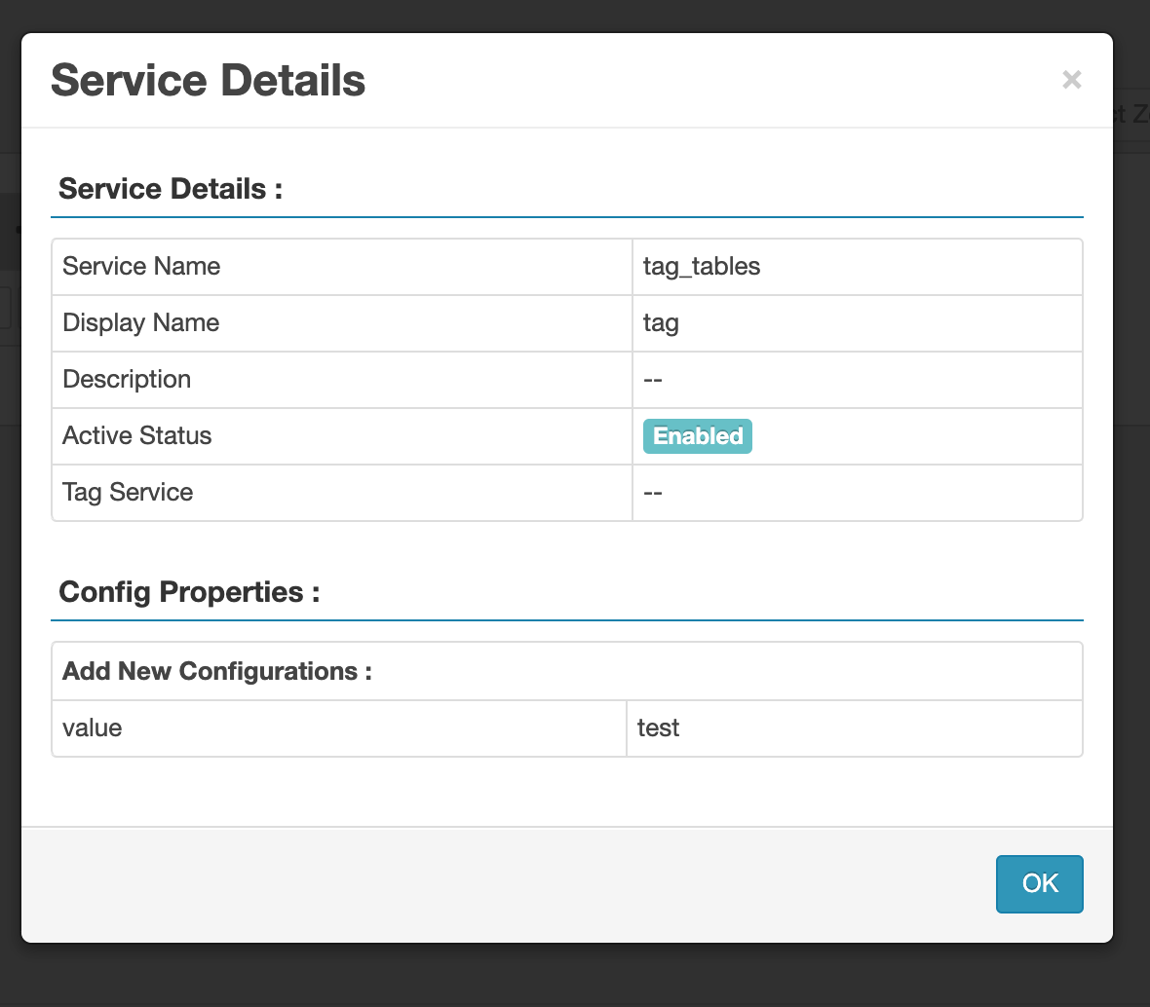
Tag based policy

Slide 43
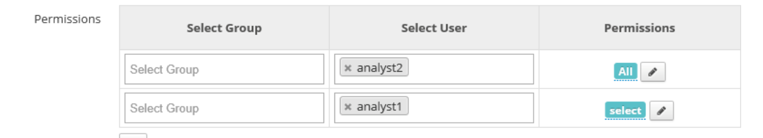
Update the Policy

Slide 44
Retry query with Analyst1

Slide 45
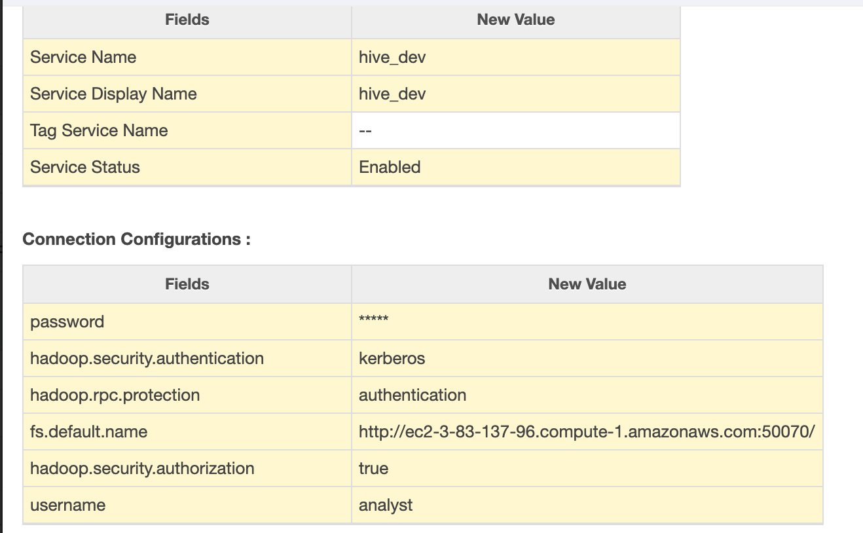
Create HDFS and Hive services in Ranger

Slide 46
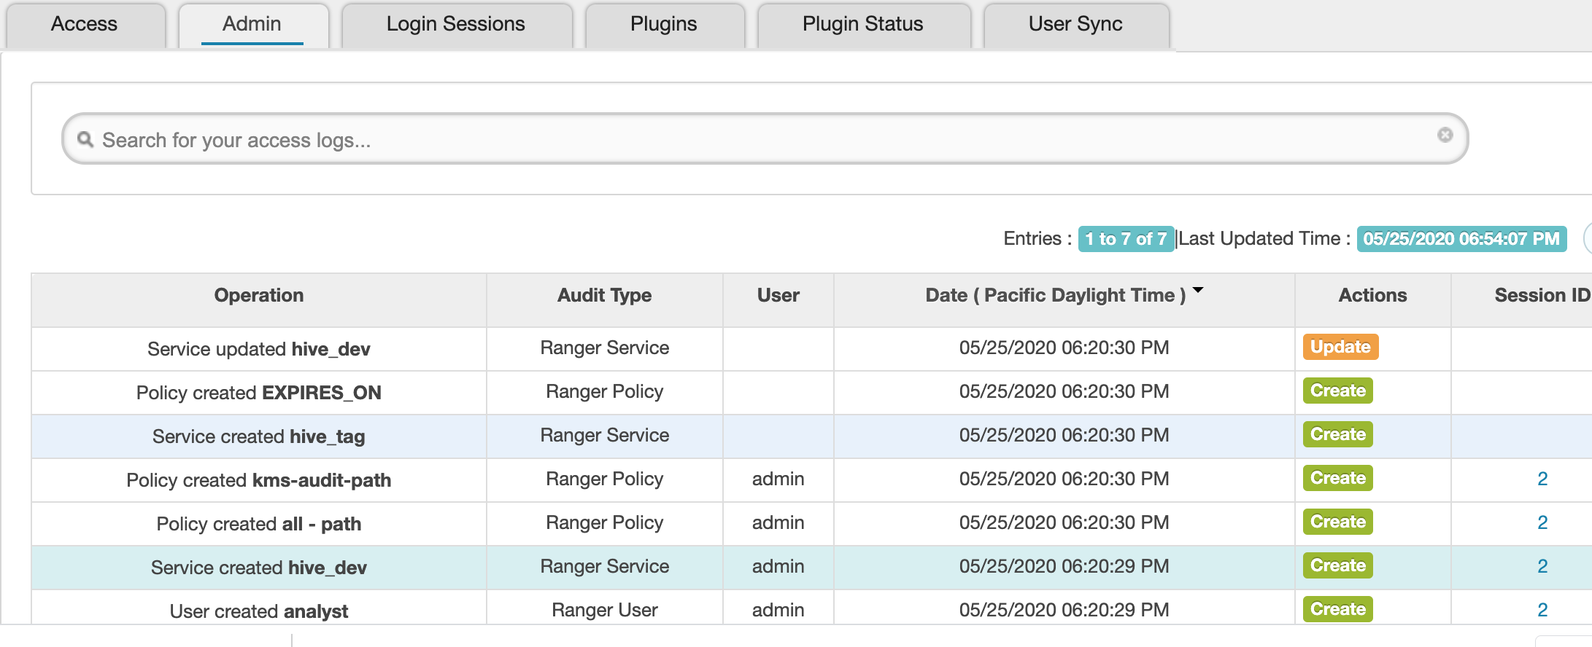
Admin Ranger Policies

Slide 47
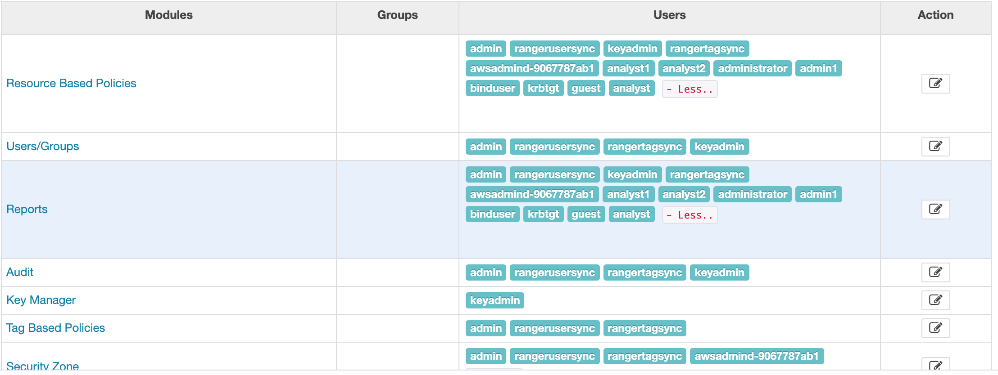
Users and Permissions

Slide 48
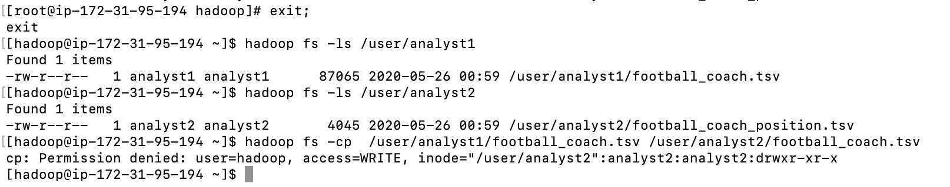
Hadoop user can’t move files

